Slide 1
DA2 PROJECT IMPLEMENTATION SUBMISSION
Automated AWS Receipt Processing System
Serverless extraction and structured data storage

Slide 2
Course & Submission Details
SUBMITTED BY
SAGNIK BISWAS
Reg. No: 24BEE1250
COURSE INFORMATION
Advanced Cloud Computing
Course Code: BECE355L

Slide 3

Problem Statement
Time-Consuming: Slow manual data entry.
Error-Prone: High risk of human typos.
Manual Processing
Poor Scaling: Cannot handle high-volume spikes.
Traditional receipt handling is a massive operational bottleneck.

Slide 4



Scope of the Project
Data Extraction
Structured Storage
Automated Alerts
AI-powered OCR via Textract.
Scalable NoSQL DynamoDB records.
Real-time SES email notifications.

Slide 5





Project Flow Diagram
Event-driven serverless architecture
Amazon Textract
User Upload
Amazon S3
AWS Lambda
DynamoDB
Trigger Event
Orchestrator
Amazon SES

Slide 6






Core Services Utilized
Amazon S3
AWS Lambda
Amazon Textract
Image storage layer.
Compute orchestrator.
Receipt OCR engine.
DynamoDB
Amazon SES
AWS IAM
Structured database.
Notification dispatch.
Secure access roles.

Slide 7
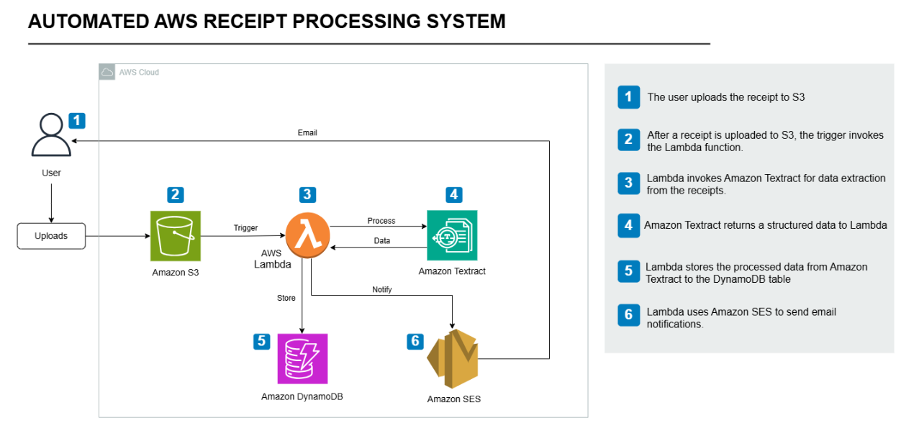

Implementation: Storage Layer
Bucket Creation: Dedicated S3 bucket configured.
File Support: Accepts both PNG and PDF uploads.
[ Paste S3 Implementation Screenshot Here ]
Event Trigger: `s3:ObjectCreated:*` invokes Lambda.

Slide 8
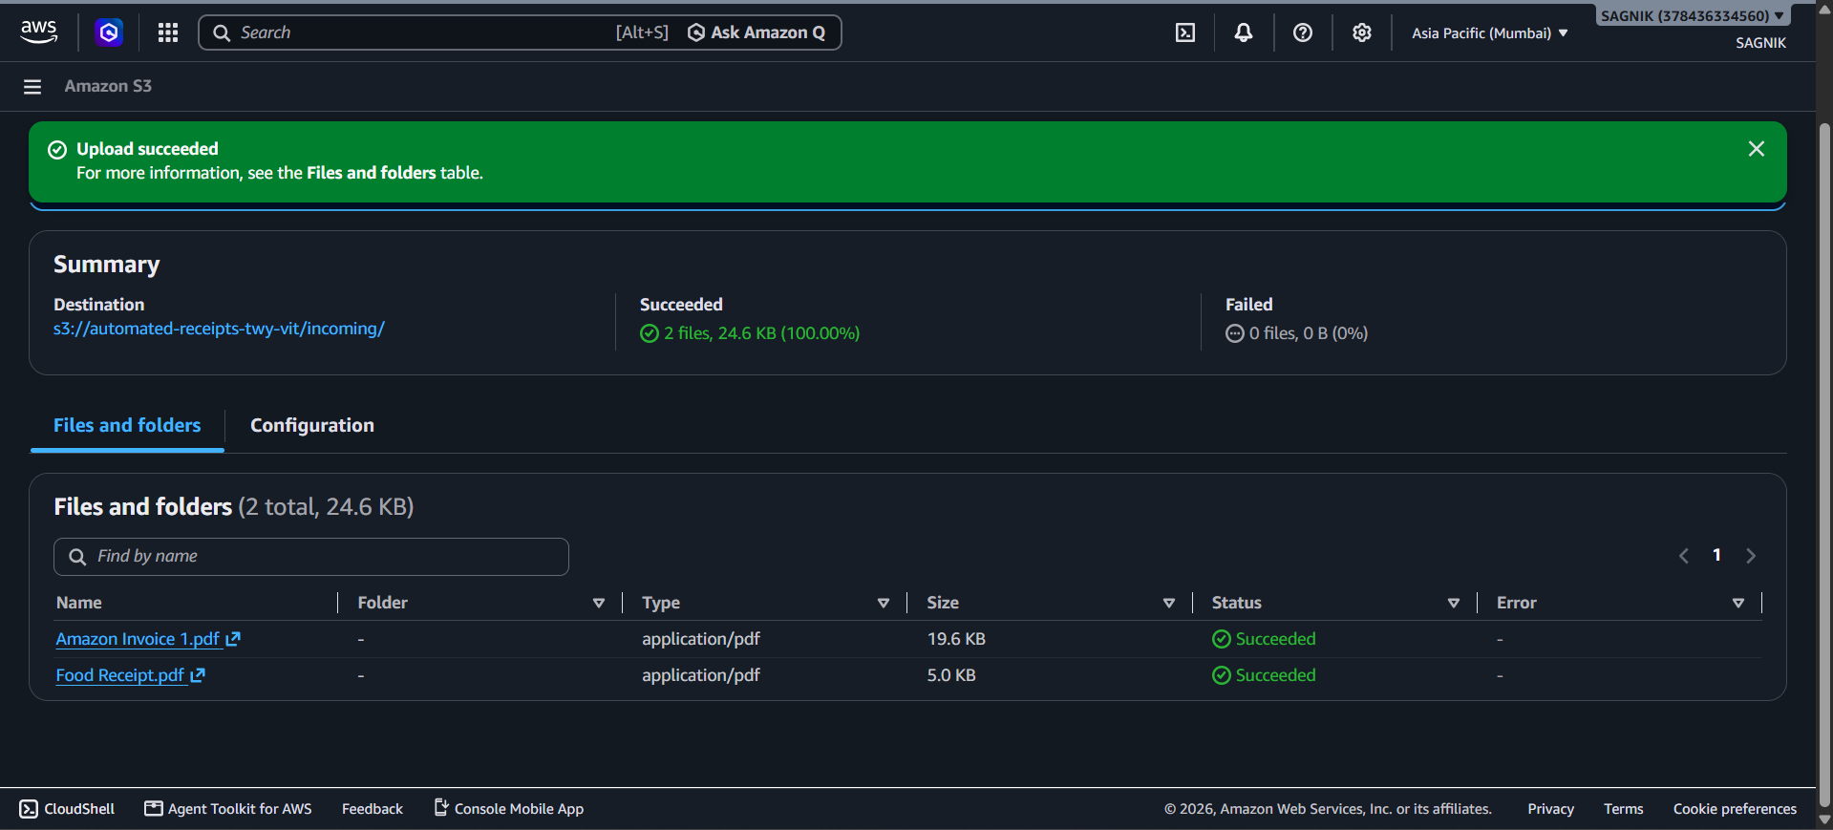
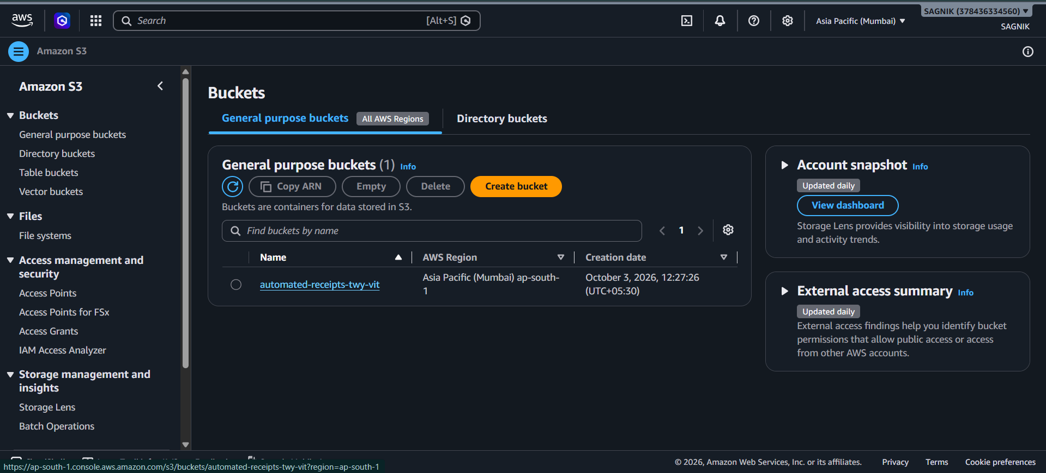
Implementation: Processing Layer
Textract API: Calls `analyze_expense` method.
Summary Extraction: Identifies Vendor, Date, and Total.
[ Paste Textract Execution Screenshot Here ]
Line Items: Parses individual items, quantity, and price.

Slide 9
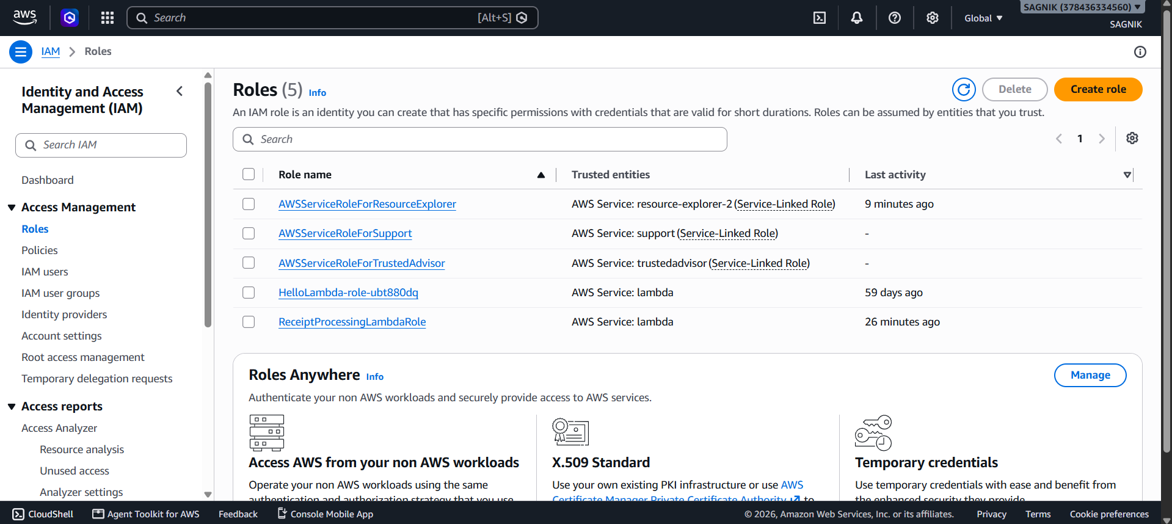
Implementation: Compute Layer Setup
Environment: Python 3.x runtime utilizing Boto3.
IAM Role: Granted S3 read, Textract, DB write, SES send.
[ Paste Lambda Configuration Screenshot Here ]
Variables: Set DYNAMODB_TABLE and SES_EMAILS.

Slide 10
Lambda Execution Core
def lambda_handler(event, context):
# Get S3 bucket and key
bucket = event['Records'][0]['s3']['bucket']['name']
key = urllib.parse.unquote_plus(...)
# 1: Process receipt with Textract
data = process_receipt_with_textract(bucket, key)
# 2: Store results in DynamoDB
store_receipt_in_dynamodb(data, bucket, key)
# 3: Send email notification
send_email_notification(data)
return {'statusCode': 200}
Sequential Automation
The Lambda function acts as the central orchestrator, passing the payload seamlessly through extraction, storage, and notification phases.
Zero idle compute

Slide 11
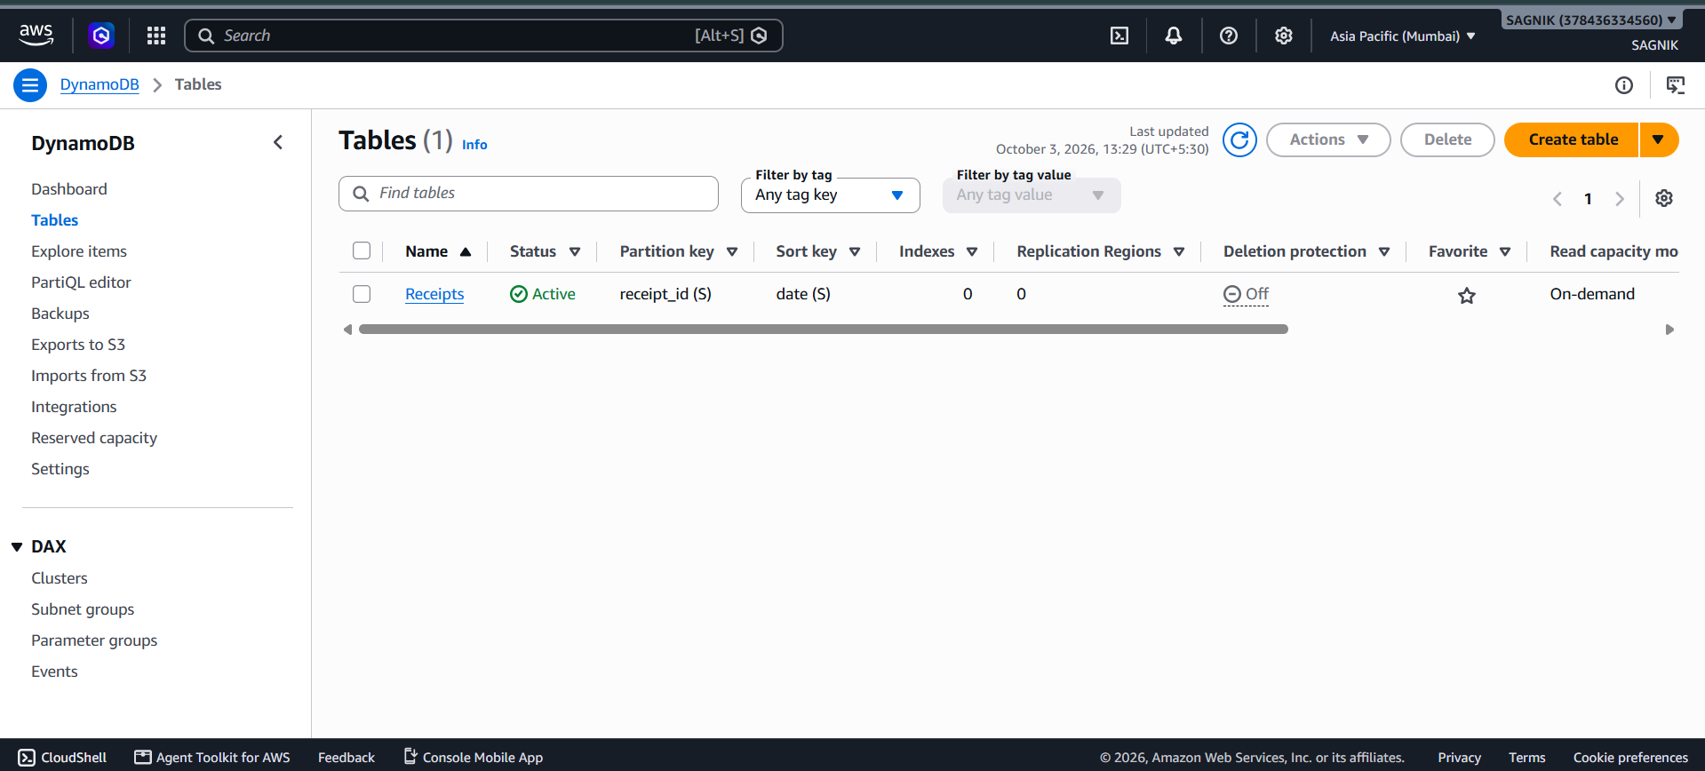
Implementation: Database Layer
Table Setup: DynamoDB 'Receipts' table generated.
Primary Key: Unique UUID assigned to `receipt_id`.
[ Paste DynamoDB Item Screenshot Here ]
Schema mapping: Stores vendor, total, and nested items list.

Slide 12
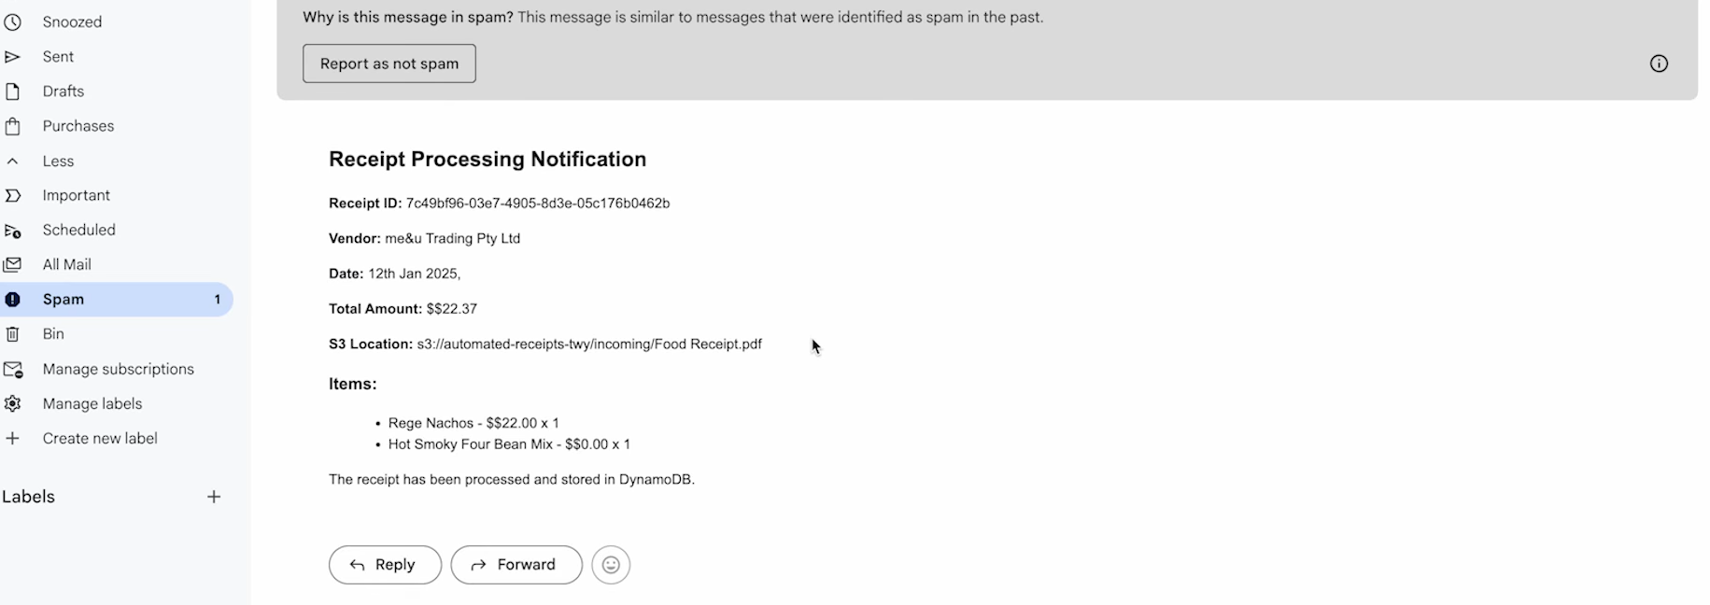
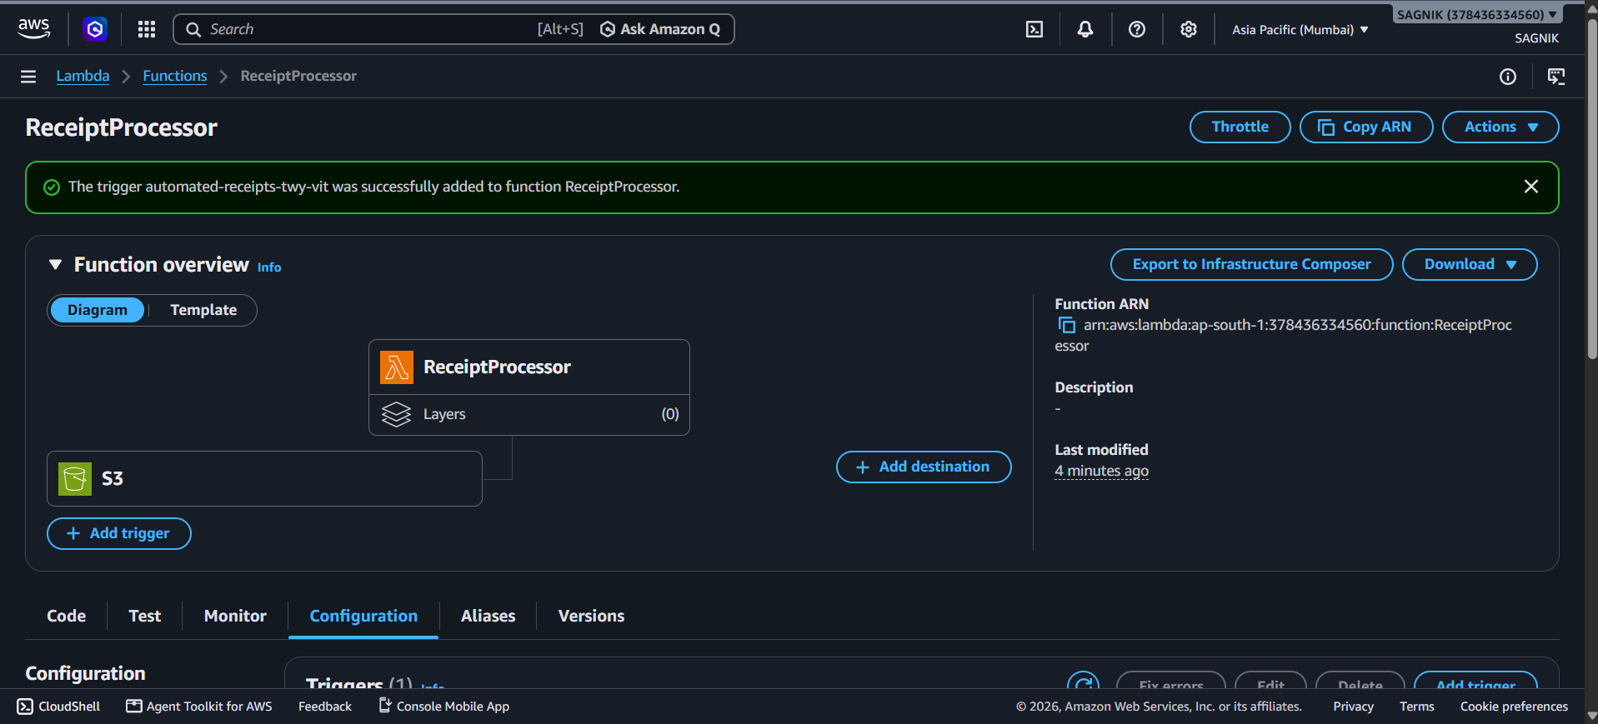
Implementation: Notification Setup
Identity Verification: Sender/Receiver emails verified in SES.
HTML Formatting: Lambda constructs readable HTML body.
[ Paste SES Configuration / Email Code Screenshot Here ]
Delivery Dispatch: Boto3 SES client handles final push.

Slide 13
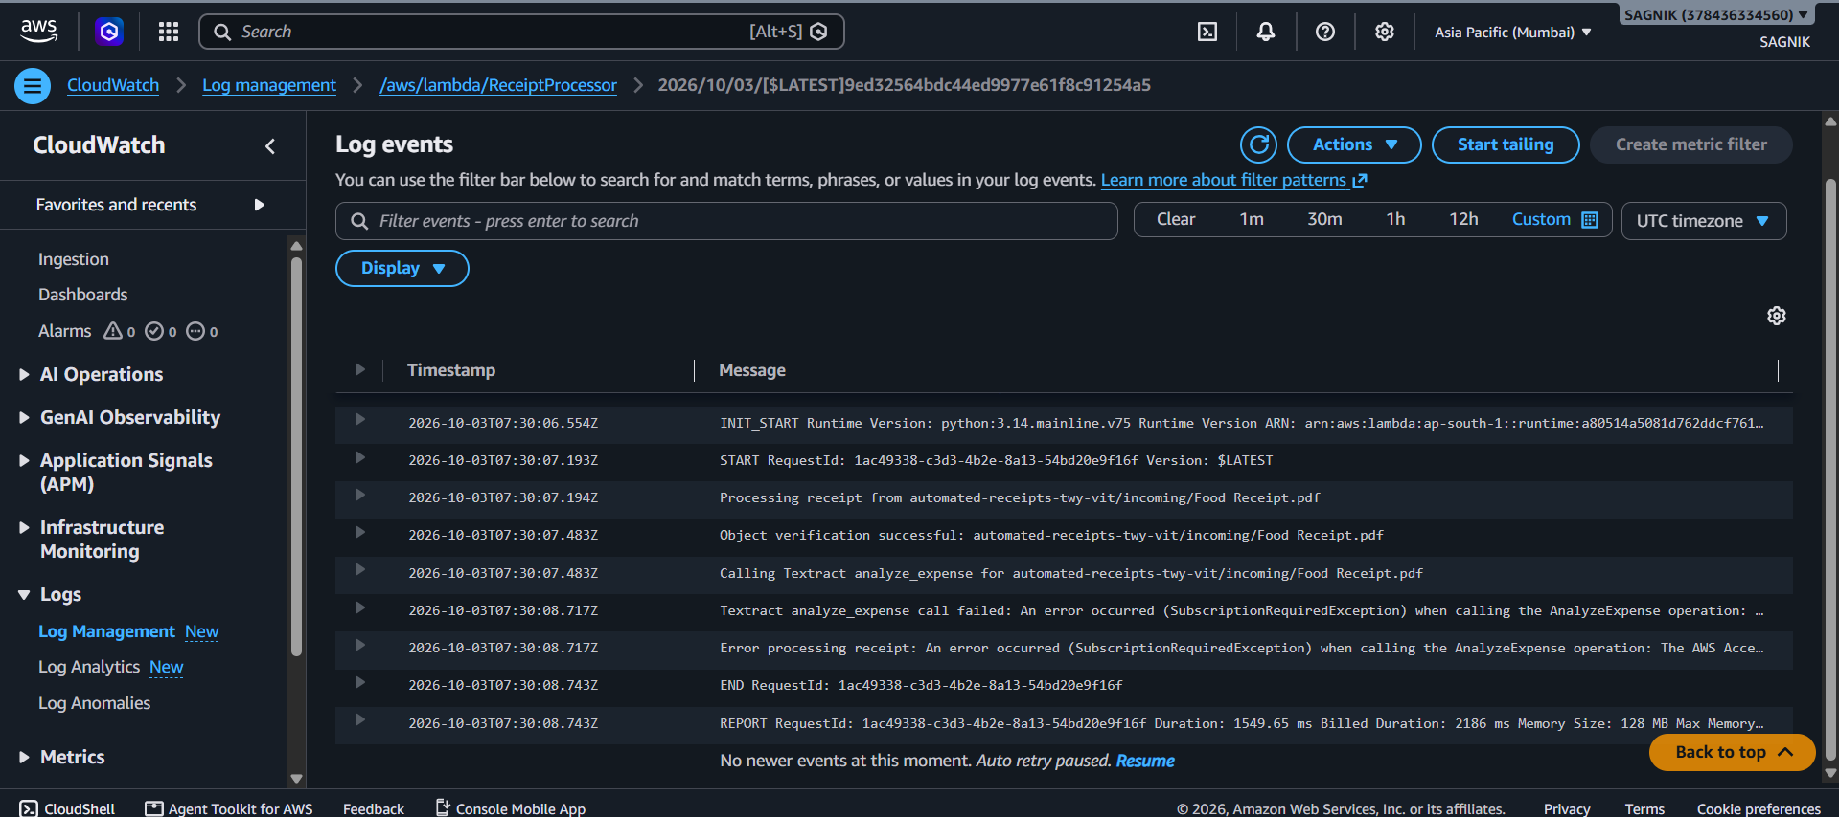

Integration & Testing Results
Upload Success: Receipt correctly dropped in S3.
Database Write: Data perfectly populated in DynamoDB.
[ Paste Final Email Received Screenshot Here ]
Email Arrival: Formatted email successfully received.

Slide 14

System Outcomes
100%
0
Automated Process
Manual Entry Required
Real-Time Execution

Slide 15
Cloud Resource Clean Up
Empty & Delete S3
Stop Textract API
Remove receipt files and bucket.
Halt calls to prevent extra costs.
Delete DynamoDB
Disable SES & IAM
Remove table and stored items.
Remove verified emails and roles.

Slide 16
Conclusion
Successfully built a highly scalable, serverless pipeline that fully automates document extraction and record-keeping with zero manual intervention.
Thank You

